Slide 1
Programming with Python
Day 1

Slide 2
Fundamentals of Computer Science: Algorithms and Information Processing
Computer science focuses on a broad set of interrelated ideas
Two of the most basic ones are:
Algorithms
Information processing

Slide 3
Algorithms
Steps for subtracting two numbers:
Step 1: Write down the numbers, with larger number above smaller one, digits column-aligned from right
Step 2: Start with rightmost column of digits and work your way left through the various columns
Step 3: Write down difference between the digits in the current column of digits, borrowing a 1 from the top number’s next column to the left if necessary
Step 4: If there is no next column to the left, stop
Otherwise, move to column to the left; go to Step 3
The computing agent is a human being
Sequence of steps that describes each of these computational processes is called an algorithm
Features of an algorithm:
Consists of a finite number of instructions
Each individual instruction is well defined
Describes a process that eventually halts after arriving at a solution to a problem
Solves a general class of problems

Slide 4
Information Processing
Information is also commonly referred to as data
In carrying out the instructions of an algorithm, computing agent manipulates information
Starts with input → produces output
The algorithms that describe information processing can also be represented as information

Slide 5
The Structure of a Modern Computer System
A modern computer system consists of hardware and software
Hardware: physical devices required to execute algorithms
Software: set of these algorithms, represented as programs in particular programming languages

Slide 6
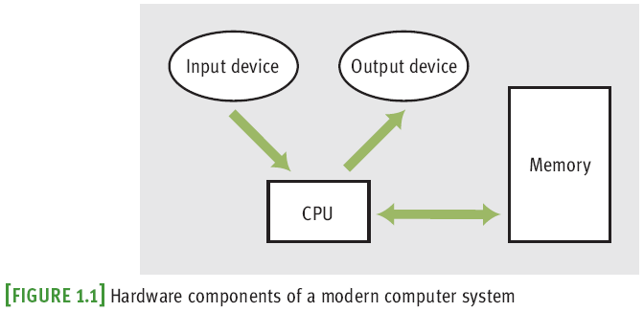
Computer Hardware
Computers can also communicate with the external world through various ports that connect them to networks and to other devices

Slide 7
Computer Hardware
Random access memory (RAM) is also called internal or primary
External or secondary memory can be magnetic, semiconductor, or optical

Slide 8
Computer Software
A program stored in computer memory must be represented in binary digits, or machine code
A loader takes a set of machine language instructions as input and loads them into the appropriate memory locations
The most important example of system software is a computer’s operating system
Some important parts: file system, user interfaces (terminal-based or GUIs)
Applications include Web browsers, games, etc.

Slide 9
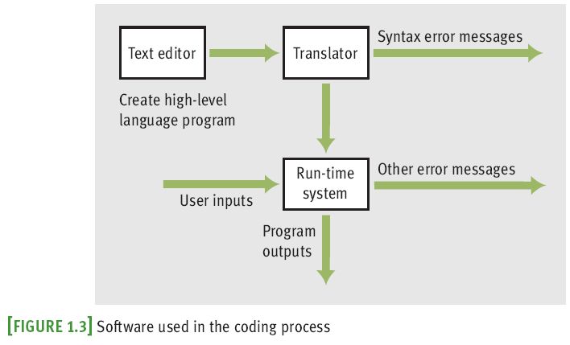
Computer Software

Slide 10
A Not-So-Brief History of Computing Systems

Slide 11
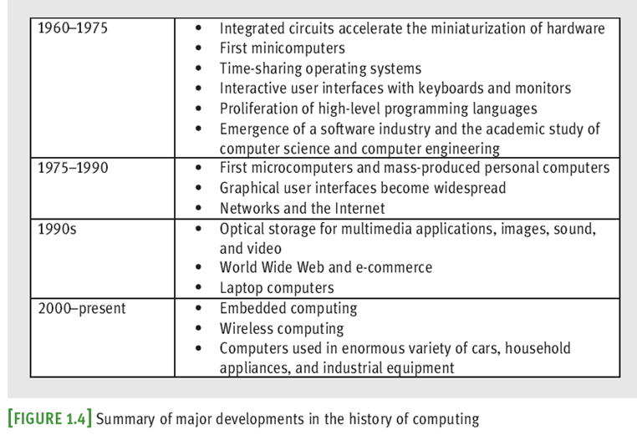
A Not-So-Brief History of Computing Systems

Slide 12
Before Electronic Digital Computers
“Algorithm” comes from Muhammad ibn Musa Al-Khawarizmi, a Persian mathematician
Euclid developed an algorithm for computing the greatest common divisor of two numbers
The abacus also appeared in ancient times
Blaise Pascal (1623–1662): built one of the first mechanical devices to automate addition
Joseph Jacquard (1752–1834): designed and constructed a machine that automated weaving
Charles Babbage (1792–1871): conceived Analytical Engine

Slide 13
Before Electronic Digital Computers
Herman Hollerith (1860–1929): developed a machine that automated data processing for the U.S. Census
One of the founders of company that became IBM
George Boole (1815–1864): developed Boolean logic
Alan Turing (1912–1954): explored the theoretical foundations and limits of algorithms and computation

Slide 14
The First Electronic Digital Computers (1940–1950)
Late 1930s: Claude Shannon wrote paper titled “A Symbolic Analysis of Relay and Switching Circuits”
1940s:
Mark I (electromechanical)
ENIAC (Electronic Numerical Integrator and Calculator)
ABC (Atanasoff-Berry Computer)
Colossus by a group working under Alan Turing
John von Neumann: first memory-stored programs
Mainframe computers consisted of vacuum tubes, wires, and plugs, and filled entire rooms

Slide 15
The First Programming Languages (1950–1965)
The first assembly languages had operations like
ADD and OUTPUT
Programmers entered mnemonic codes for operations at keypunch machine
Card reader—translated holes in cards to patterns in computer’s memory
Assembler—translated application programs in memory to machine code
High-level programming languages: FORTRAN, LISP, COBOL
common feature: abstraction

Slide 16
Integrated Circuits, Interaction, and Timesharing (1965–1975)
Late 1950s: vacuum tube gave way to transistor
Transistor is solid-state device
Early 1960s: integrated circuit enabled smaller, faster, less expensive hardware components
Moore’s Law: processing speed and storage capacity of HW will increase and cost will decrease by approximately a factor of 2 every 18 months
Minicomputers appeared
Processing evolved from batch processing → time-sharing → concurrent

Slide 17
Personal Computing and Networks (1975–1990)
Late 1960s: Douglas Engelbart
First pointing device (mouse) and software to represent windows, icons, and pull-down menus on a bit-mapped display screen
Member of team that developed Alto (Xerox PARC)
1975: Altair, first mass-produced personal computer
With Intel’s 8080 processor, first microcomputer chip
Early 1980s: Gates and Allen build MS-DOS
Bob Metcalfe created Ethernet, used in LANs
ARPANET grew into what we call Internet

Slide 18
Consultation, Communication, and Ubiquitous Computing (1990–Present)
Optical storage media developed for mass storage
Virtual reality: capacity to create lifelike 3-D animations of whole-environments
Computing is becoming ubiquitous, yet less visible
Berners-Lee at CERN created WWW
Based on concepts of hypermedia
HTTP: Hypertext Transfer Protocol
HTML: Hypertext Markup Language

Slide 19
Getting Started with Python Programming
Early 1990s: Guido van Rossum
invented the Python programming language
Python is a high-level, general-purpose programming language for solving problems on modern computer systems
Useful resources at www.python.org

Slide 20
Running Code in the Interactive Shell
Python is an interpreted language
Simple Python expressions and statements can be run in the shell
Easiest way to open a Python shell is to launch the IDLE
To quit, select the window’s close box or press Control+D
Shell is useful for:
Experimenting with short expressions or statements
Consulting the documentation

Slide 21
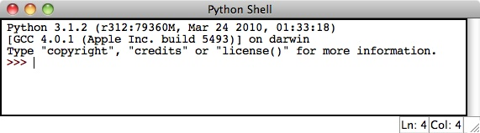

Running Code in the Interactive Shell

Slide 22
Exercise
Download and install Python and IDLE from www.python.org/downloads
Optionally, download and install PythonWin (another Python IDE for Windows)
Read the Rock-Paper-Scissors program code. What does every line of code do?
Why are there no curly braces? What is used in Python instead of the curly braces?
Write and run your first Python program in IDLE.
import time
from time import sleep
import random
sus="-"*35
depo=["rock","paper","scissors"]
while True:
x=input("rock , paper, scissors: ")
if x not in depo:
print ("Dont cheat!")
continue
pc=random.choice(depo)
sleep(0.5)
print (("Computer picked {}.").format(pc))
if x==pc:
sleep(0.5)
print (("\nIt's a draw.\n{}").format(sus))
elif x=="rock" and pc=="scissors":
sleep(0.5)
print (("\nYou win.rock beats scissors\n{}").format(sus))
elif x=="paper" and pc=="rock":
sleep(0.5)
print (("\nYou win.paper beats rock\n{}").format(sus))
elif x=="scissors" and pc=="paper":
sleep(0.5)
print (("\nYou win.scissors beats paper\n{}").format(sus))
else:
sleep(0.5)
print (("\nYou lose. {} beats {}\n{}").format(pc,x,sus))
input()

Slide 23
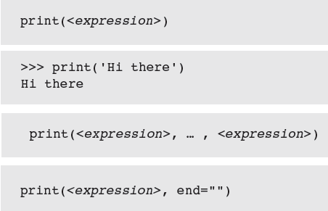
Input, Processing, and Output
Programs usually accept inputs from a source, process them, and output results to a destination
In terminal-based interactive programs, these are the keyboard and terminal display

Slide 24
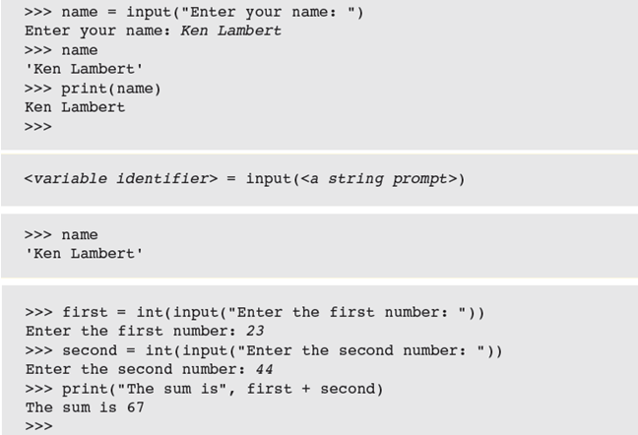
Input, Processing, and Output

Slide 25
Editing, Saving, and Running a Script
We can then run Python program files or scripts within IDLE or from the OS’s command prompt
Run within IDLE using menu option, F5 (Windows), or Control+F5 (Mac or Linux)
Python program files use .py extension
Running a script from IDLE allows you to construct some complex programs, test them, and save them in program libraries to reuse or share with others

Slide 26
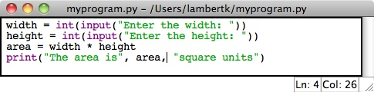

Editing, Saving, and Running a Script

Slide 27
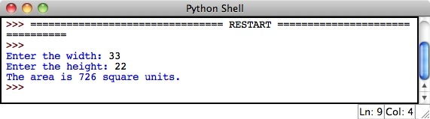
Editing, Saving, and Running a Script

Slide 28
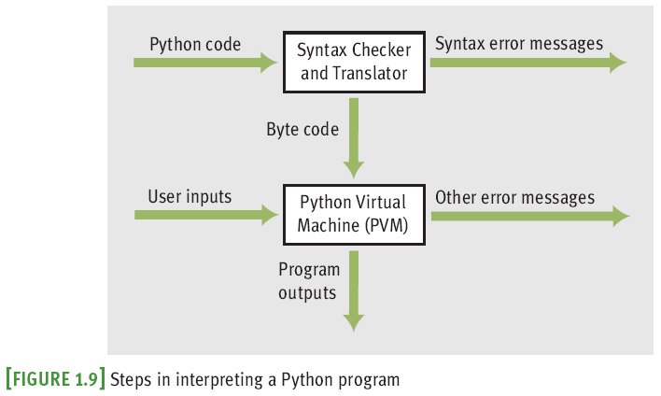
Behind the Scenes: How Python Works

Slide 29
Detecting and Correcting Syntax Errors
Programmers inevitably make typographical errors when editing programs, called syntax errors
The Python interpreter will usually detect these
Syntax: rules for forming sentences in a language
When Python encounters a syntax error in a program, it halts execution with an error message

Slide 30
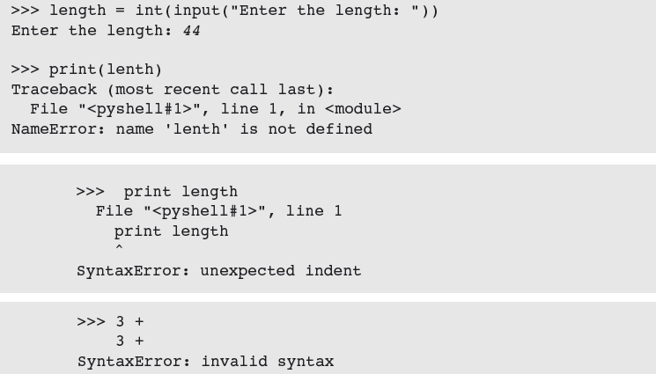
Detecting and Correcting Syntax Errors

Slide 31
Summary
Fundamental ideas of computer science
The algorithm
Information processing
Real computing agents can be constructed out of hardware devices
CPU, memory, and input and output devices
Some real computers are specialized for a small set of tasks, whereas a desktop or laptop computer is a general-purpose problem-solving machine
Software provides the means whereby different algorithms can be run on a general-purpose hardware device
Written in programming languages
Languages such as Python are high-level
Interpreter translates a Python program to a lower-level form that can be executed on a real computer
Python shell provides a command prompt for evaluating and viewing the results of Python expressions and statements

Slide 32
Summary
IDLE is an integrated development environment that allows the programmer to save programs in files and load them into a shell for testing
Python scripts are programs that are saved in files and run from a terminal command prompt
When a Python program is executed, it is translated into byte code
Sent to PVM for further interpretation and execution
Syntax: set of rules for forming correct expressions and statements in a programming language

Slide 33
Exercise
Write a Python program that computes the area of a triangle. Issue the appropriate prompts for the triangle’s base and height, using the appropriate variable names. Then use the formula 0.5 * base * height to compute the area. Save and test the program through the IDLE window.
Write a program that accepts the user’s name (as text) and age (as a number) as input. The program should output a sentence containing the user’s name and age.
Enter the expression help() at the shell prompt. Follow the instructions to browse the help topics and modules.

